Slide 1
Power BI Financial Analyst
Introduction
Importance
Interface
Shahzaib Hamid
AI Sciences Instructor

Slide 2

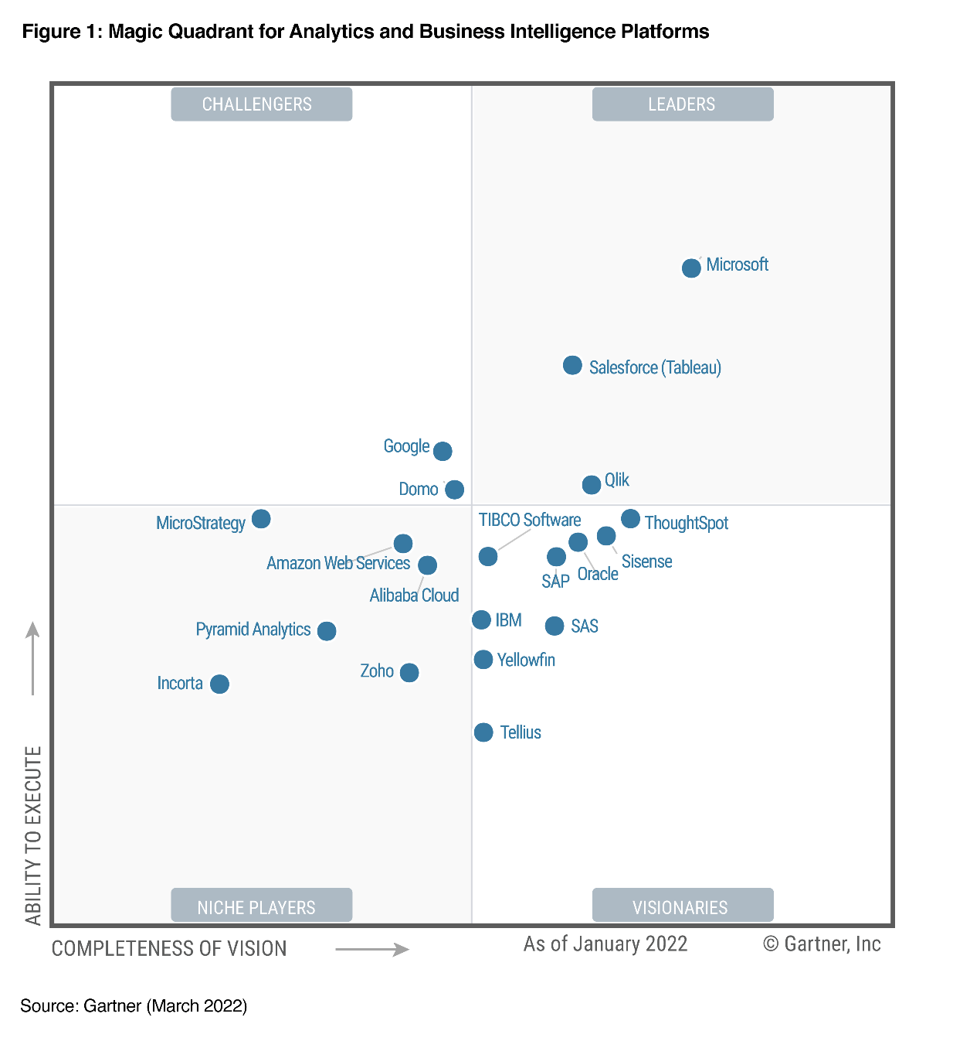

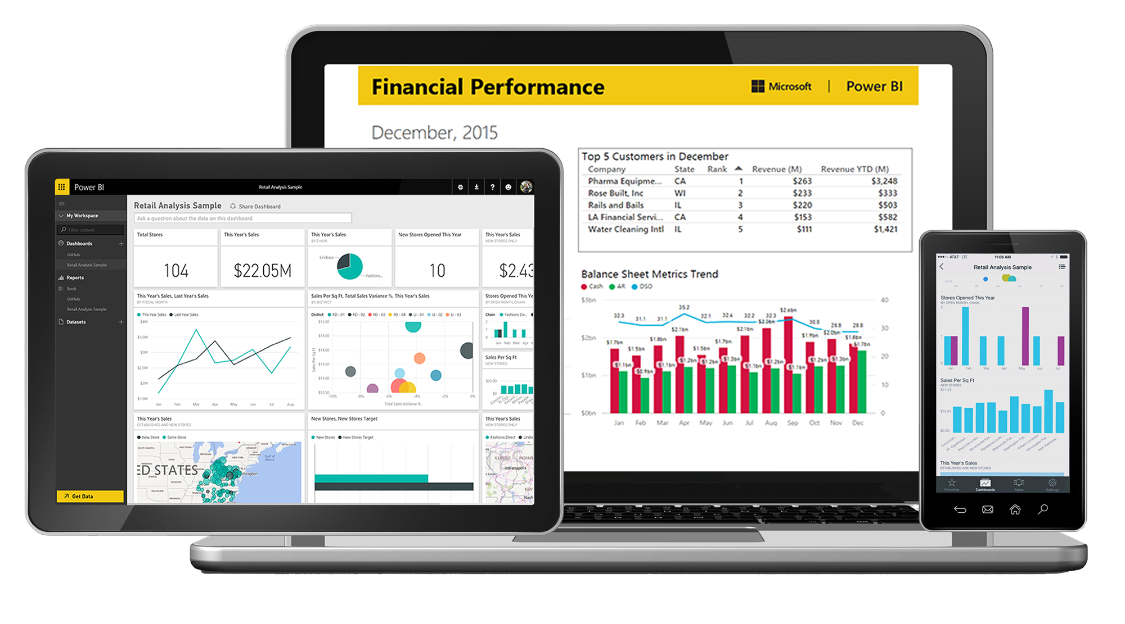
MEET POWER BI
Power BI is a standalone Microsoft business intelligence product that includes desktop and web-based applications for loading, modeling, and visualizing data.
More information at powerbi.microsoft.com

Slide 3
WHY POWER BI
Connect, transform, and analyze millions of rows of data
Access data from virtually anywhere (database tables, flat files, cloud services, folders, etc.), and create fully automated data shaping and loading (ETL) procedures
Build relational models to blend data from multiple sources
Create table relationships to analyze holistic performance across an entire data model
Define complex calculations using Data Analysis Expressions (DAX)
Enhance datasets and enable advanced analytics with powerful and portable DAX expressions
Visualize data with interactive reports & dashboards
Build custom business intelligence tools with best-in-class visualization and dashboard features
Power BI is the industry leader among BI platforms
Microsoft Power BI is intuitive, powerful, and absolutely FREE to get started

Slide 4
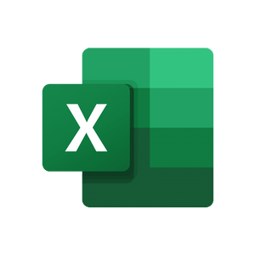

Power Excel vs Power BI
Power Excel
Power BI
Power Excel and Power BI are built on top of the exact same engine!
Power BI takes the same data shaping, modeling, and analytics capabilities and adds new reporting and publishing tools.
PivotTables
Report View
Data Shaping (Power Query)
Data Modeling (Power Pivot)
Calculated Fields (DAX)
Custom
Visualization Tools
(R-Visuals, Bookmarks,
Interactions, etc.)
CUBE Functions
Pivot Charts
Publishing &
Collaboration Options
Power Map/ Power View
VS

Slide 5
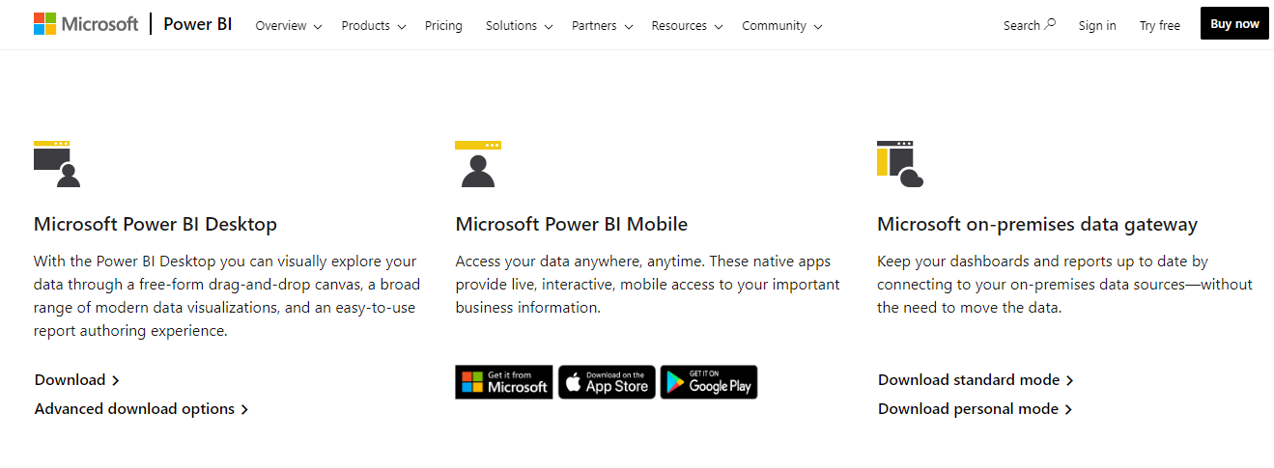
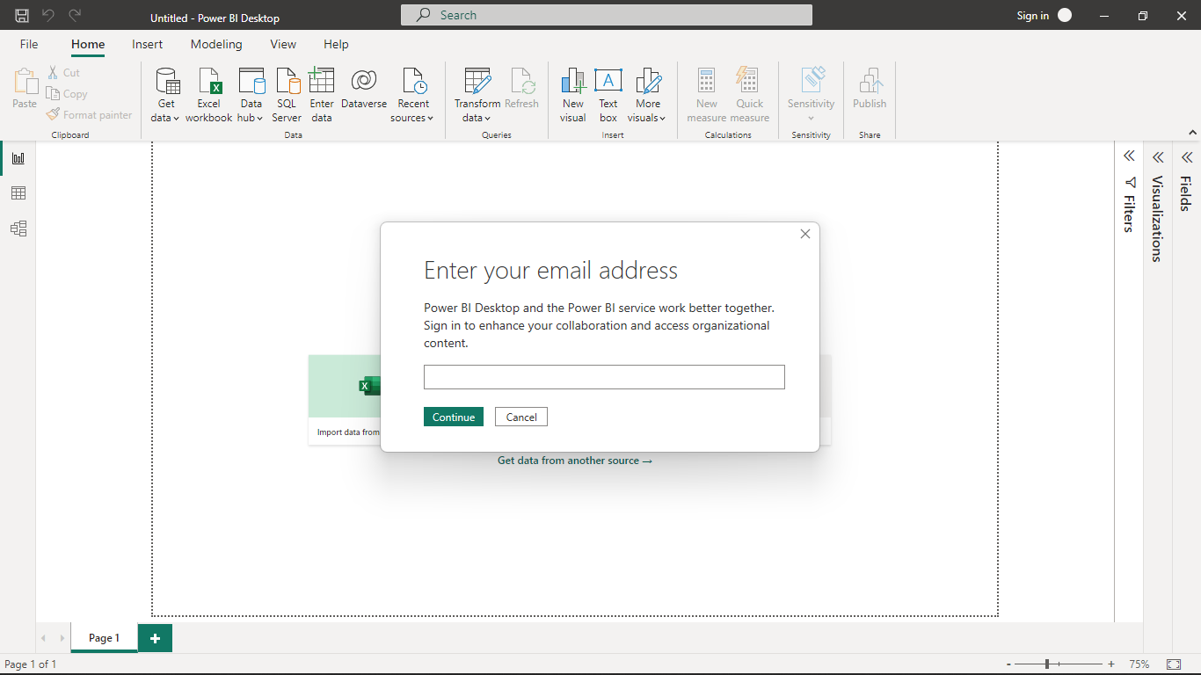
Installing Power BI Desktop
Open powerbi.microsoft.com and Click on Download under Microsoft Power BI Desktop.
Download
Important: You do not need to sign in or register for a Power BI Pro account to access Power BI Desktop, Microsoft requires work or school e-mail address.
Sign-in is only required to access the sharing and collaboration tools available through Power BI Service (app.powerbi.com)

Slide 6
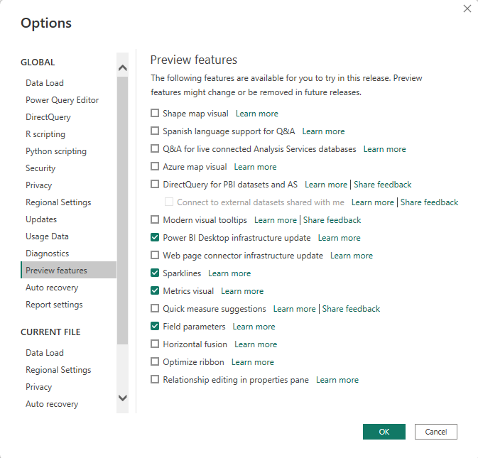
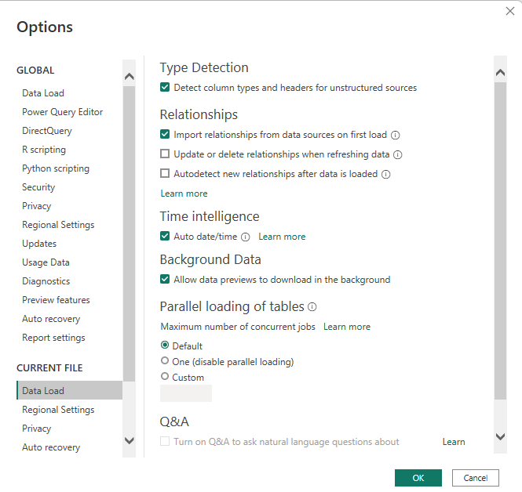
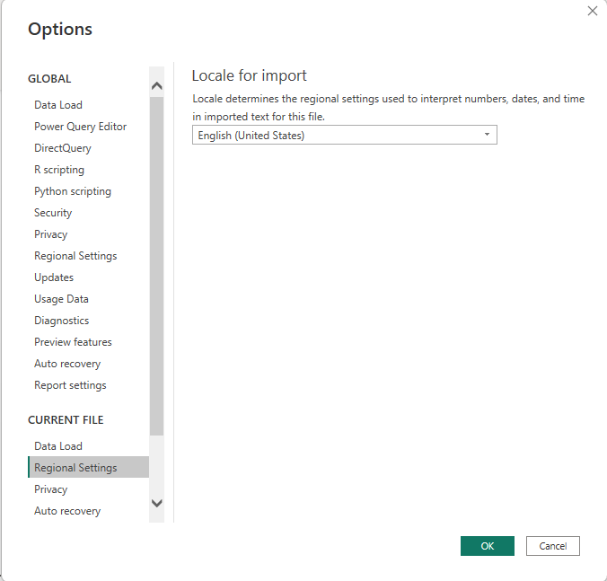
Power BI Options and Settings
Preview features
Data load
Regional Settings
In the Preview Features options, untick/tick these active features.
In the Data Load options, untick the “Update relationships” and “Autodetect new relationships after data is loaded” options.
In the Regional Settings options, make sure to use the English (United States) locale for import.

Slide 7
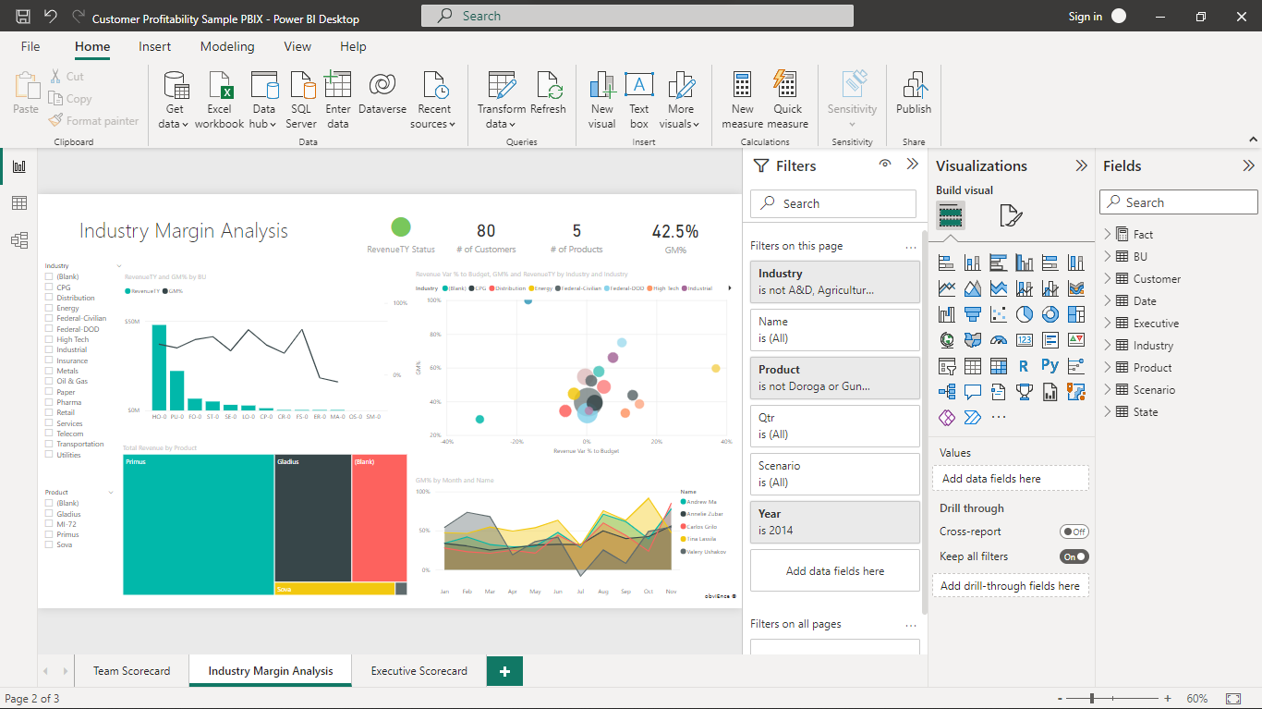



The Power BI Interface
Three Core Views:
Report
Data
Relationships
(aka Model)

Slide 8
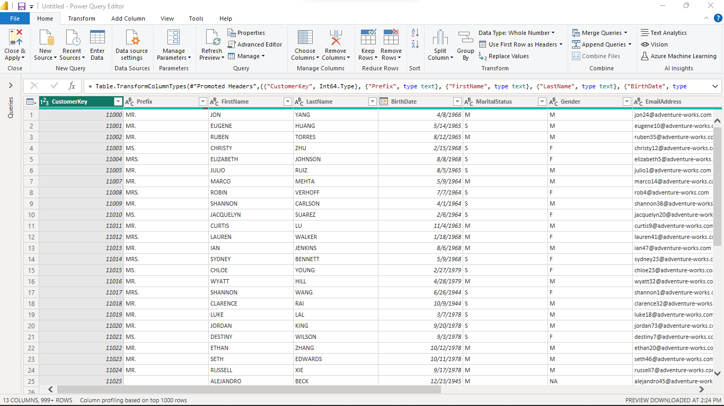
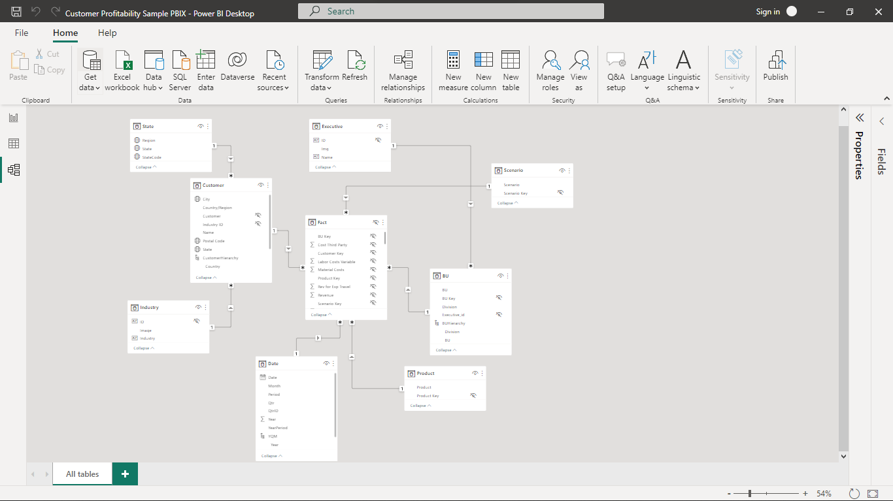
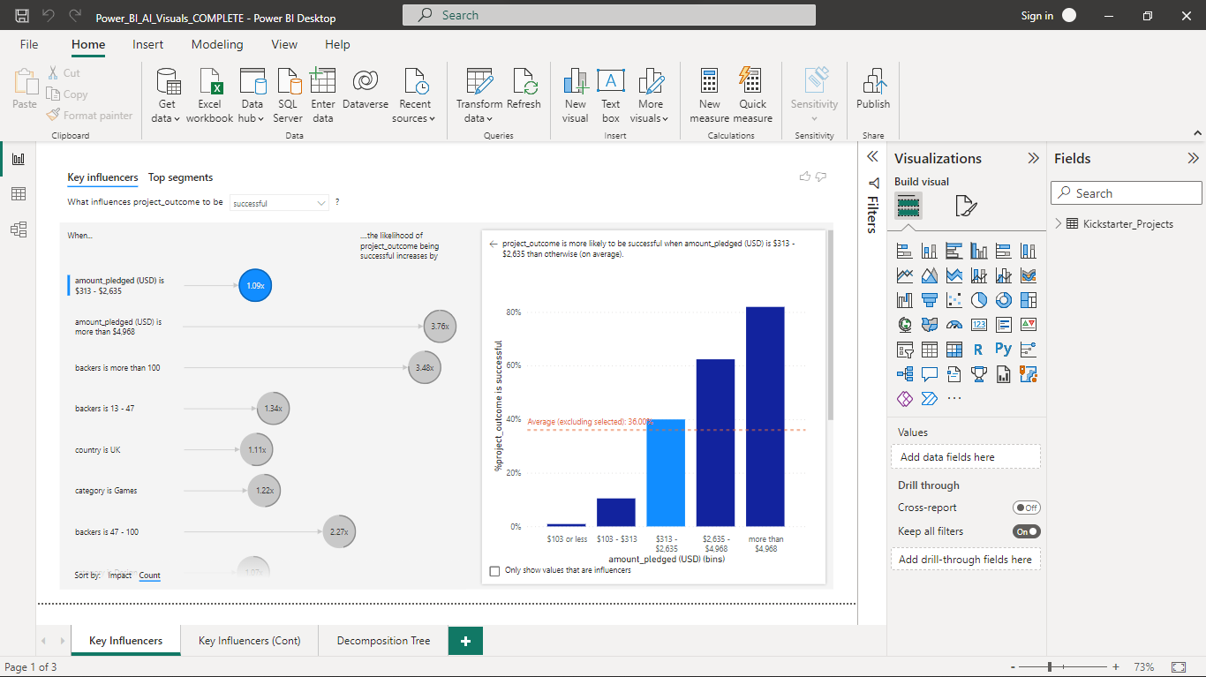
The Power BI Workflow
Connect, shape and transform raw data.
Build table relationships to create a data model.
Design interactive reports to explore and visualize data.

Slide 9

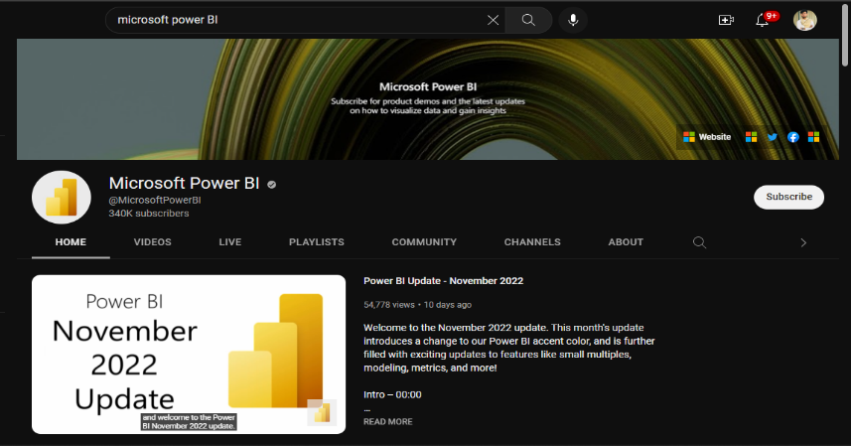
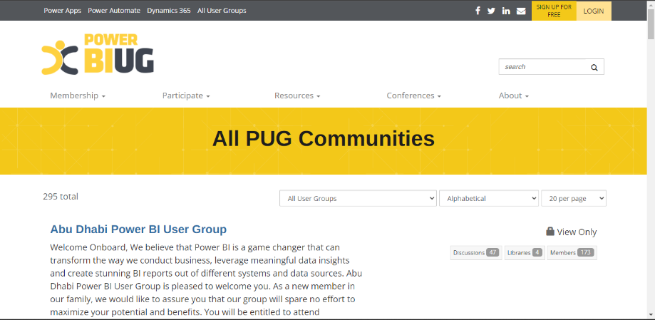
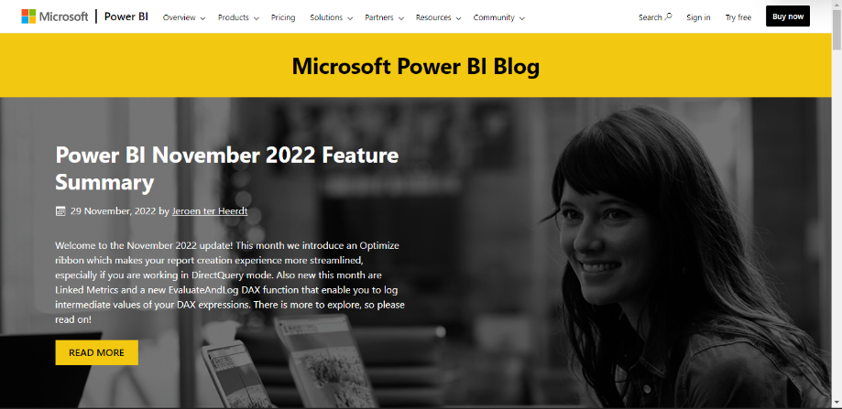
Power BI Resources
The Help tab includes documentation, training videos, sample files, templates, and links to support blogs and communities. (all within Power BI Desktop)
The Microsoft Power BI blog (powerbi.microsoft.com/blog) publishes monthly summaries to showcase new features.
The Microsoft Power BI YouTube Channel publishes demos, feature summaries, and advanced tutorials.
Power BI User Groups (PUG) are communities of users, which include both local meet-ups and helpful online forums (pbiusergroup.com)

Slide 10
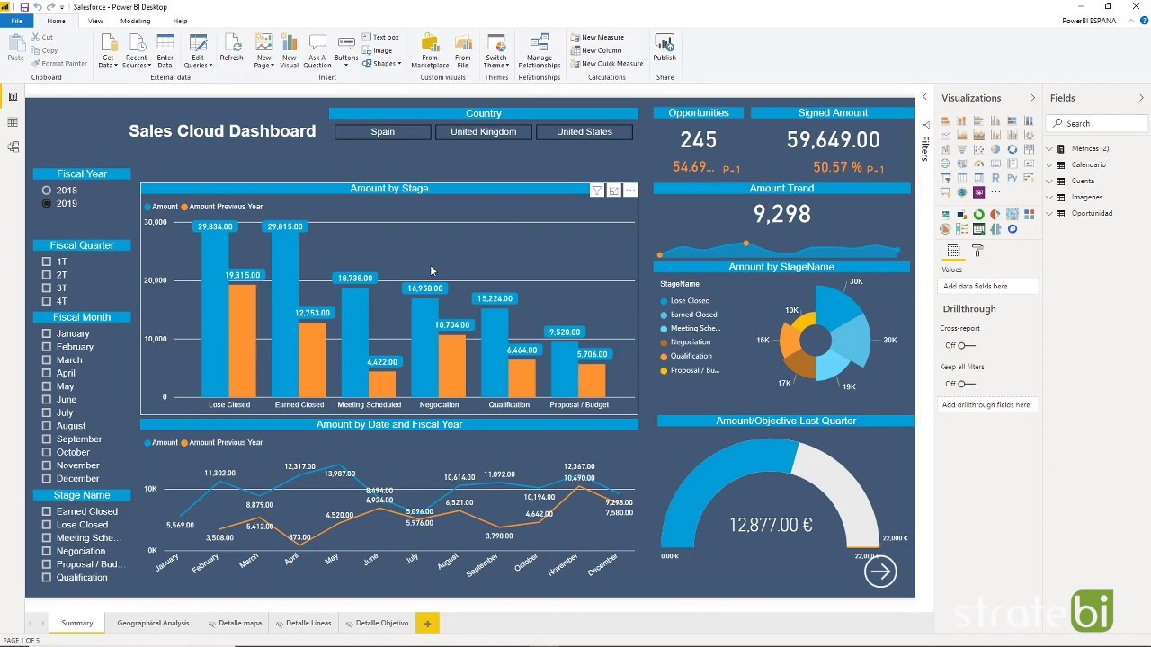
Power BI Ribbon
NOTE: Microsoft introduced a new ribbon design for Power BI Desktop as a preview feature in Nov. 2021, and rolled it out to general availability in Mar/Apr 2022
So what’s new?
Contextual menus, activated by user selections (Format, Data/Drill, Table/Column/Measure Tools)
Consistent style & structure across Office applications (Excel, Word, PowerPoint)
Accessibility tools (alt key tips, tab controls, etc.).
New report themes and intuitive design previews

Slide 11



Report View TABS
HOME*:
The original Home tools are now split across Home & Insert
INSERT:
MODELING:
VIEW:
HELP*:
* The Home and Help menus are accessible across ALL views (Report, Data & Model).

Slide 12
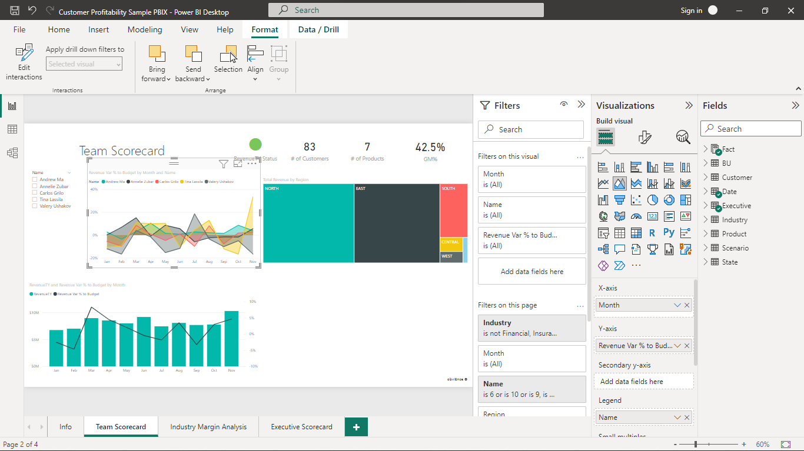
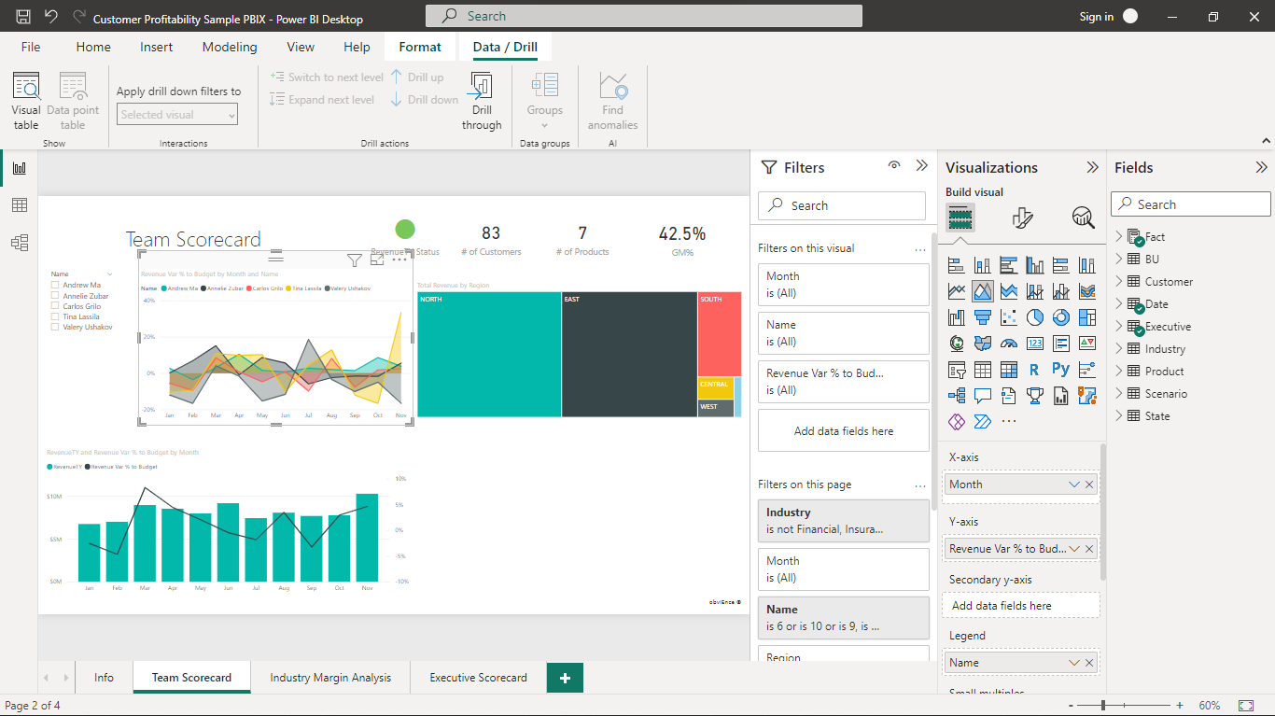
REPORT VIEW TABS (CONTEXTUAL)
FORMAT:
DATA/DRILL:
Select a visual in the Report View to access the Format and Data/Drill menus, where you can access alignment tools, edit interactions, and configure drill-down and drill-through functionality.
NOTE: You can also access contextual Table Tools, Column Tools, and Measure Tools menus by selecting items from the Fields pane while in Report View.

